Slide 1
Norwood, Colorado
New Library Facility

Slide 4
The Library has a practice of turning outward into the community, providing programs that reflect the needs of the community and expecting excellence in all that we do.
This approach has gained our library state, regional and national attention for our innovation, community engagement and quality Early Literacy programming.
Speaking opportunities:
Early Literacy Summer Reading Program- Jessica Johnson (library staff) and Virginia Kile (UNBOCS)-
MPLA/CAL conference -October ,2016- Librarians from 12 States.
Community Engagement- Carrie Andrew (Library Director)
CoPLA- Aug, 2015- 60+ librarians
PLA (Public Library Association) – April, 2016, National library conference
Webinar for Texas Libraries- August, 2016- all small libraries in Texas
Rocky Mountain City Summit, October, 2016- cross-sector leaders from 8 states

Slide 5
Project Description:
Greater opportunities for the community and the region.
Not only will we be expanding the library’s space and building substantial community meeting space, we will , also, be providing space for the Chamber of Commerce to have a Visitor’s Center and for the Colorado Supreme Court Law Library to house an Equal Access Center.

Slide 6
Problem statement:
With a 369% increase in attendance at our children’s programs over the last five years, the kids need more space.

Slide 7
Demonstration of Problem:
May, 2012 -Patron Survey of library needs – ¼ of community responded
June. 2013 community input event regarding new library
July, 2013 District name officially changed
January, 2014 Town, Library and Rec. -joint committee
Summer 2014- Feasibility Study
May, 2015 Rec district dropped out due to their lack of organizational readiness
December, 2015 Library completed Conceptual Design with Endreson.
Spring, 2013 Community survey to choose new name
December 2012 – Purchased Land
Fall 2014- working with Chris Endreson, CCCD UTA

Slide 8
Feasibility Study:
over 70 community leaders were interviewed about the prospect of a joint library/community recreation center project.
Who we talked to: (about 16% in some government [town, county, fire, etc.], 8% non-profit, 33% business, the rest prominent and active community members)
Top needs: meeting space (classroom, activity, program, social). Good shared space.
Almost 70% of the respondents describe the community as being between Impasse (stuck, frozen) and Catalyst (things starting to happen).
Top library needs
1. Collection space
2. Children's space
3. Computer space
4. Meeting space (programs)
5. Others (historical, hangout space, study)
Top parks and recreation needs
1. Pool (but lots of concerns) – 15 respondents
2. Gym - 15 - also basketball, weights, exercise, could be dance
3. Classroom space - 14
4. Meeting/gathering - 11
5. Tennis courts - 10
6. Indoor track - 9
Advice
1. Get something done!
2. Don't duplicate existing services or amenities
3. Keep money requests modest (BUT...)
4. Don't cut corners
5. Get the costs worked out, and identify partners to help raise money
6. Look into medical partners
7. Remember both safety and ADA accessibility
8. Keep people in the loop - we are looking for social interaction
9. Consider outside use - RV, outside trails, park, playground

Slide 9
Local Effort:
If asking for full $4million at 5% over 20 years plus additional operating:
Residential: $63 a year per $100,000
Commercial: $229 a year per $100,000
Most citizens say that a library is worth the increase but there is concern from those on fixed incomes, large landowners and some commercial property owners.

Slide 10
Readiness to Go and Operational Capacity:
Monet Ragsdale
Development Director at Leadership Circle
Library Board member, Chair of Building Committee
”I have had this position for 5 years.
I worked as an Operations Manager/Safety Director for Summit Roofing for 8.5 years. My degree is in City Planning.
Building commercial projects is what I do all day every day. Right now I have 4 stores under construction, 4 locations in entitlement, and 6-8 locations in design. All of these projects have budgets of $5 million+”
Conceptual Design is complete.
RFP’s will be written prior to November and ready to go once we are successful at the ballot.

Slide 11
Energy/Mineral Relationship:
While this industry has its periods of boom and bust, the library remains a constant in our community, changing the nature of our services to meet the needs that come with industry ebb and flow.

Slide 12
Project Budget:
San Miguel County | $50,000
Foundation Grants
· Adolph Coors – Community room | $10,000 | 10,000-50,000
· Bacon Family Foundation | $5,000 | 5000-50,000 |  |  | Mesa County library received $120,000 for capital
· Boettcher Foundation | $25,000 | 10,000-50,000
· El Pomar Foundation | $50,000 | 2,500-30000
· Gates Family Foundation | $100,000 | 100,000 -250,000
· John G Duncan Trust | $2,500 | up to $5000 |  |  | Wells Fargo not capital
· Just for Kids Foundation – kids furniture | $5,000
· Kerr Foundation | $5,000 | 1000-5000
· Telluride Foundation | $100,000
Subtotal – Foundation Grants | $302,500

Slide 13
Project Pros:
Improved quality of life
Ability to offer expanded programs-
Amphitheater for outdoor performances
Colorado Mountain College Classes
Dark Sky materials- references, telescopes, events
Regional conferences
Family Events
Educational programs
Technology instruction
Outdoor learning-
Greenhouse – instruction and demonstration of gardening techniques
Apple Core Project
Seed Library
Walking trail for families and seniors

Slide 14
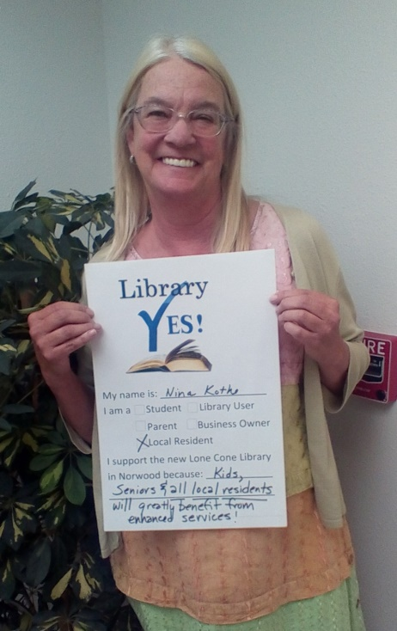
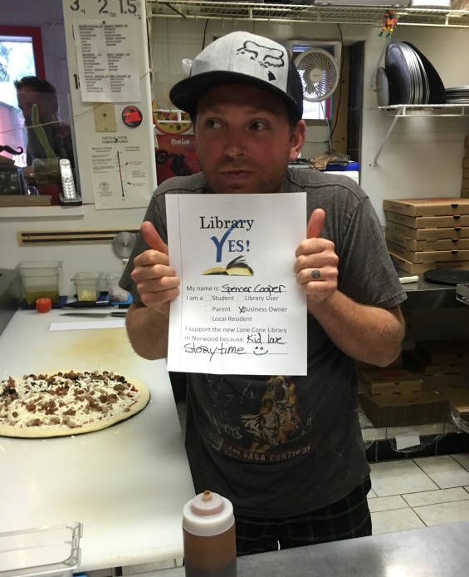
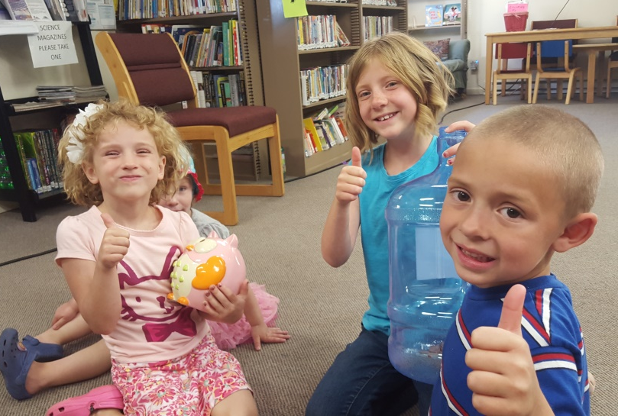
Project Cons:
No mill levy approval until November
YES Committee already formed and poised for action.
Support campaign begun.
Seeking as many other sources of income as possible.

Slide 15
Question 1: Partnership break down and fees
Equal Access Center (Supreme Court Library)- they will furnish and help bring programming
Chamber of Commerce- they will furnish and staff as needed
Meeting space- typically nonprofits will have use of the space for a nominal or no fee. Other uses will be charged. See example from Fruita.
Meeting Rooms The Fruita Community Center Meeting Room is 1860 square feet and is finished with wood flooring. The meeting room can be partitioned into three separate rooms. Individual rooms, as well as the entire meeting room are available for rental. The outside patio is included in each rental. (In the area of the room rented) Capacity for the Meeting Room is 93 persons.
*rent 2 rooms or more the deposit does not exceed $100.00 / 200.00 w/alcohol
Room | Rental Rate | Refundable Deposit
Cherry | $30.00/hr | $50.00 / 100.00 w/alcohol
Peach | $30.00/hr | $50.00 / 100.00 w/alcohol
Plum | $30.00/hr | $50.00 / 100.00 w/alcohol
Full MTG Room | $90.00/hr | $100.00 / 200.00 w/alcohol*
Kitchen | $30.00/hr | $100.00

Slide 16
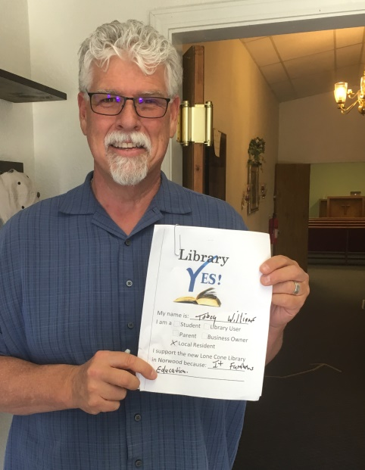
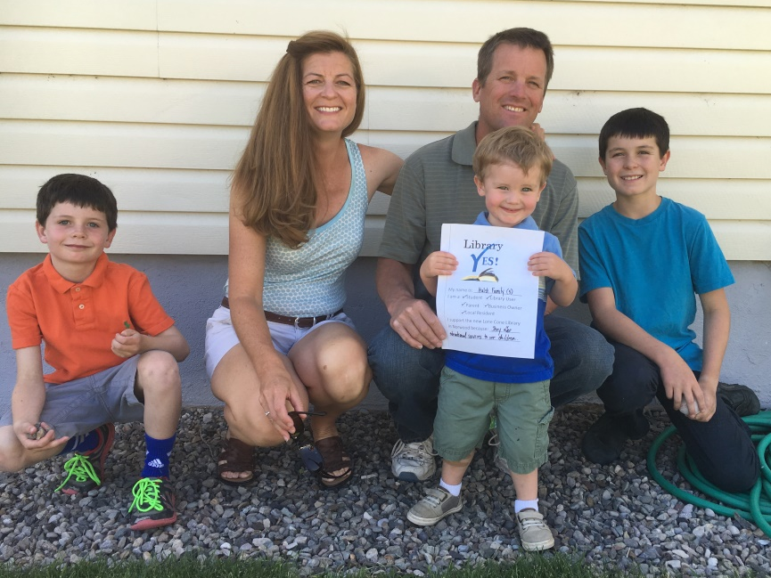
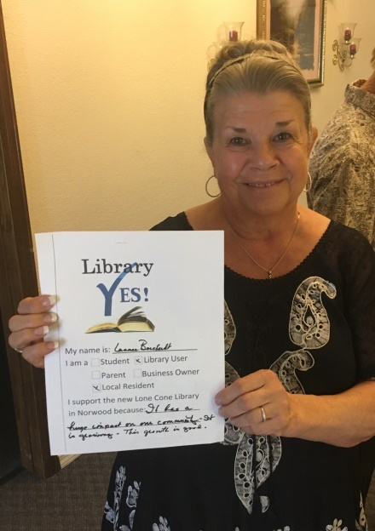
Question 2: Grant Funding
State Library grants- Contacted Eugene Hainer, State Librarian, no grants are available for capital projects.
Foundation grants- refer to table on Project budget slide or attached spreadsheet
Other Fundraising – County support, Corporate Donors, Individual Donors, Fundraisers like naming opportunities.

Slide 17
